Slide 1
Density-based Clustering

Slide 2
Density-based clustering is a type of unsupervised machine learning technique used to identify clusters (groups) in data based on the density of data points in the feature space.
Unlike methods like k-means, which assume clusters are spherical and of similar size, density-based methods can find clusters of arbitrary shape and handle noise/outliers effectively.
They are non-parametric, robust to noise, and don’t need the number of clusters specified.
Clusters are formed where the density of points is high, separated by regions of low density.
A point belongs to a cluster if it is within a dense region of points.
Density = number of points within a specified radius r (Eps)

Slide 3
Major Types of Density-Based Clustering Algorithms
Connectivity based:
DBSCAN, GDBSCAN, OPTICS and DBCLASD
Density function based:
DENCLUE

Slide 4
DBSCAN is the most popular Density-Based Clustering Algorithm and it performs well in handling real-world data irregularities such as:
Arbitrary-Shaped Clusters: Clusters can take any shape not just circular or convex.
Noise and Outliers: It effectively identifies and handles noise points without assigning them to any cluster.

Slide 5
Key Parameters in DBSCAN
1. Eps (epsilon): This defines the radius of the neighborhood around a data point.
If the distance between two points is less than or equal to eps they are considered neighbors. A common method to determine eps is by analyzing the k-distance graph.
Choosing the right eps is important:
If eps is too small most points will be classified as noise.
If eps is too large clusters may merge and the algorithm may fail to distinguish between them.
2. MinPts: This is the minimum number of points required within the eps radius to form a dense region. A general rule of thumb is to set
MinPts >= D+1 where D is the number of dimensions in the dataset.
For most cases a minimum value of MinPts = 3 is recommended.

Slide 6
DBSCAN works by categorizing data points into three types:
Core points which have a sufficient number of neighbors within a specified radius (epsilon)
Border points which are near core points but lack enough neighbors to be core points themselves
Noise points which do not belong to any cluster.
By iteratively expanding clusters from core points and connecting density-reachable points, DBSCAN forms clusters without relying on rigid assumptions about their shape or size.

Slide 7
DBSCAN (Density-Based Spatial Clustering of Applications with Noise)The most common and foundational density-based clustering algorithm.
Parameters:
ε (epsilon) → Radius of the neighborhood around a point.
minPts → Minimum number of points required to form a dense region.
Concepts:
Core Point: A point with at least minPts neighbors within distance ε.
Border Point: A point that is not a core point but lies within the neighborhood of a core point.
Noise Point (Outlier): A point that is neither a core nor a border point.

Slide 8
How Density-based clustering works (In Simple words)
Core concept: Clusters are defined as areas with a high concentration of data points. Regions with very few points are considered noise or outliers.
Identifying core points: The algorithm identifies "core points," which are data points with a minimum number of neighbors within a specified distance (called the epsilon, ε).
Expanding clusters: A cluster is formed by connecting core points to their neighboring points.
Border points: These are points that are not core points but are within the epsilon neighborhood of a core point, and are added to the cluster.
Noise points: These are points that are neither core nor border points and are labeled as noise.

Slide 9
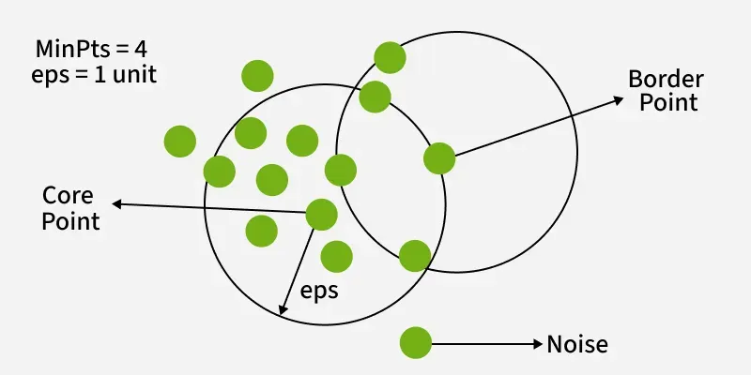
DBSCAN Datapoints

Slide 10
Steps in the DBSCAN Algorithm
DBSCAN operates by examining the neighborhood of each point in the dataset. The algorithm follows a step-by-step process to identify clusters based on the density of data points. Let's break down how DBSCAN works:
Parameter Selection
  Choose ε (epsilon): The maximum distance between two points for them to be considered as neighbors.
  Choose MinPts: The minimum number of points required to form a dense region.
Select a Starting Point
  The algorithm starts with an arbitrary unvisited point in the dataset.
Examine the Neighborhood
  It retrieves all points within the ε distance of the starting point.
  If the number of neighboring points is less than MinPts, the point is labeled as noise (for now).
  If there are at least MinPts points within ε distance, the point is marked as a core point, and a new cluster is formed.

Slide 11
4. Expand the Cluster
  All the neighbors of the core point are added to the cluster.
  For each of these neighbors:
    If it's a core point, its neighbors are added to the cluster recursively.
    If it's not a core point, it's marked as a border point, and the expansion stops.
5. Repeat the Process
  The algorithm moves to the next unvisited point in the dataset.
  Steps 3-4 are repeated until all points have been visited.
6. Finalize Clusters
  After all points have been processed, the algorithm identifies all clusters.
  Points initially labeled as noise might now be border points if they're within ε distance of a core point.
7. Handling Noise
  Any points not belonging to any cluster remain classified as noise.
This process allows DBSCAN to form clusters of arbitrary shapes and identify outliers effectively. The algorithm's ability to find clusters without specifying the number of clusters beforehand is one of its key strengths.

Slide 12
Choosing DBSCAN Parameters
The effectiveness of DBSCAN heavily depends on the choice of its two main parameters: ε (epsilon) and MinPts. Here's how to approach selecting these parameters:
Selecting ε (Epsilon)
(a). Use domain knowledge: If you have insight into what distance is meaningful for your specific problem, use that as a starting point.
(b). K-distance graph: This is a more systematic approach:
Calculate the distance to the k-th nearest neighbor for each point (where k = MinPts).
Plot these k-distances in ascending order.
Look for an "elbow" in the graph – a point where the curve starts to level off.
The ε value at this elbow is often a good choice.

Slide 13
2. Selecting MinPts
(a). General rule: A good starting point is to set MinPts = 2 * num_features, where num_features is the number of dimensions in your dataset.
(b). Noise consideration: If your data has noise or you want to detect smaller clusters, you might want to decrease MinPts.
(c). Dataset size: For larger datasets, you might need to increase MinPts to avoid creating too many small clusters.

Slide 14
Feature | DBSCAN | K-Means
Cluster Shape | Can identify clusters of arbitrary shapes | Assumes clusters are convex and roughly spherical
Number of Clusters | Does not require specifying the number of clusters beforehand | Requires specifying the number of clusters (K) in advance
Handling Outliers | Identifies outliers as noise points | Forces every point into a cluster, potentially distorting cluster shapes
Sensitivity to Parameters | Sensitive to epsilon and MinPts parameters | Sensitive to initial centroid positions and the choice of K
Cluster Density | Can find clusters of varying densities | Tends to find clusters of similar spatial extent and density
Scalability | Less efficient for large datasets, especially with high-dimensional data | Generally more efficient and scales better to large datasets
Consistency of Results | Produces consistent results across runs | Results can vary due to random initialization of centroids

Slide 15
Advantages of DBSCAN:
Finds clusters of arbitrary shape.
Robust to noise and outliers.
Doesn’t require specifying the number of clusters in advance.
Limitations:
Struggles with varying density.
Sensitive to the choice of ε and minPts.

Slide 16
Applications of DBSCAN
Spatial data analysis
In geographic information systems (GIS), DBSCAN can identify areas of high activity or interest.
Image processing
DBSCAN can group pixels into distinct objects for tasks like object recognition in images.
Anomaly detection
In fraud detection or system health monitoring, DBSCAN can isolate unusual patterns.

Slide 17
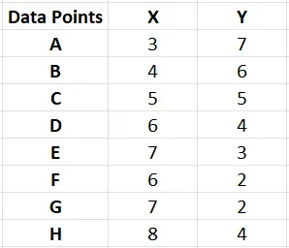
Q1. Given the points A(3, 7), B(4, 6), C(5, 5), D(6, 4), E(7, 3), F(6, 2), G(7, 2) and H(8, 4), Find the core points and outliers using DBSCAN. Take Eps = 2.5 and MinPts = 3.
Solution:
Given, Epsilon(Eps) = 2.5
Minimum Points(MinPts) = 3
Let’s represent the given data points in tabular form:

Slide 18
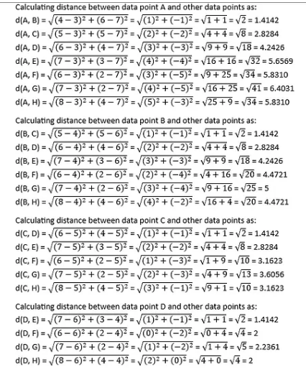
Step 1: To find the core points, outliers and clusters by using DBSCAN we need to first calculate the distance among all pairs of given data point. Let us use Euclidean distance measure for distance calculation.

Slide 19
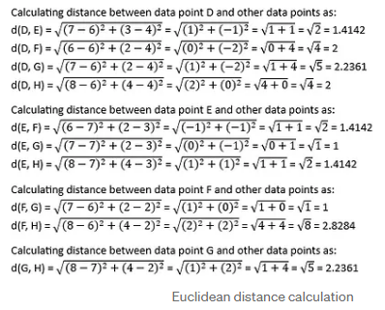

Slide 20
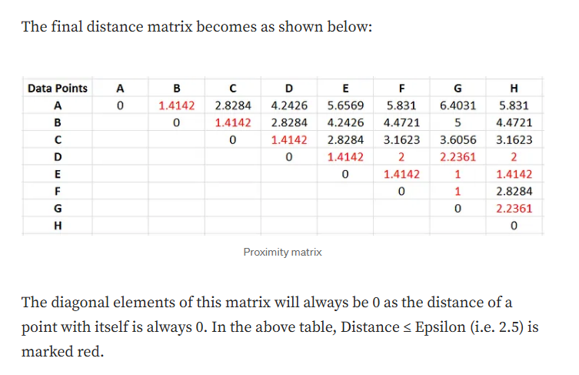
You can fill all the above calculated distance values in the table.

Slide 21
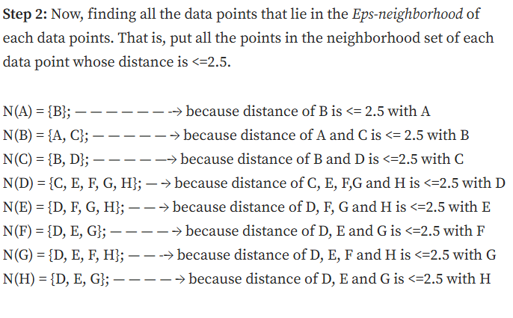

Slide 22
Data point A has Minpts<=3 so it cant be considered as a core point.
Data points B,C,D,E,F,G and H form cluster as they have MinPts>=3 so they are called core-points.
Data point A is a non-core point but not an outlier, as it is a part of a cluster {B,A,C}, and its in the neighbourhood of a core-point, B hence its called a Boundary point.
There is no outlier here.

Slide 23
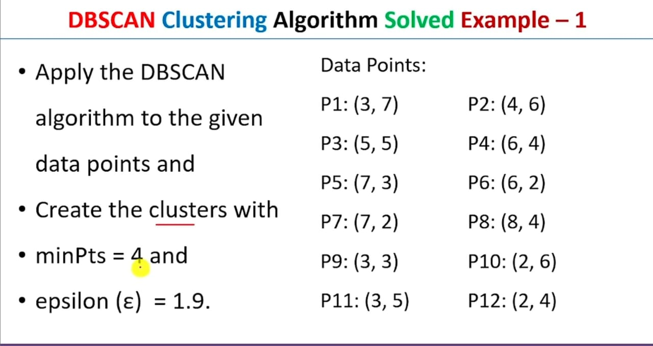
Q2. Another DBSCAN Numerical

Slide 24
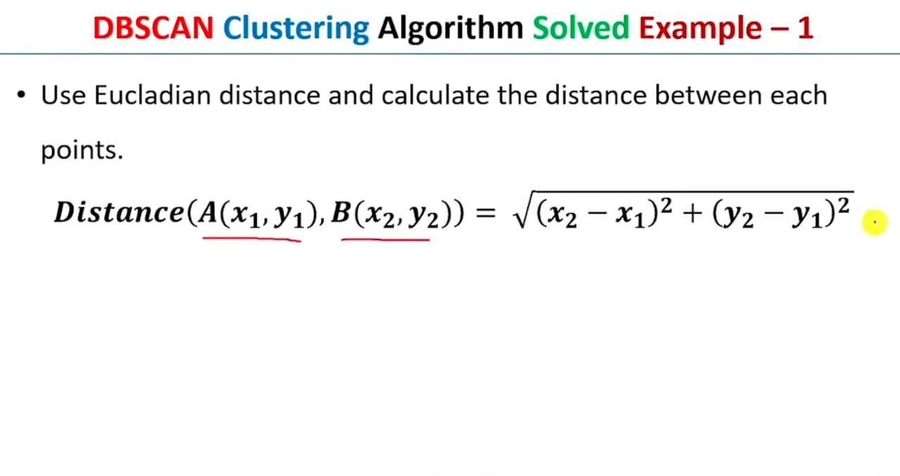

Slide 25
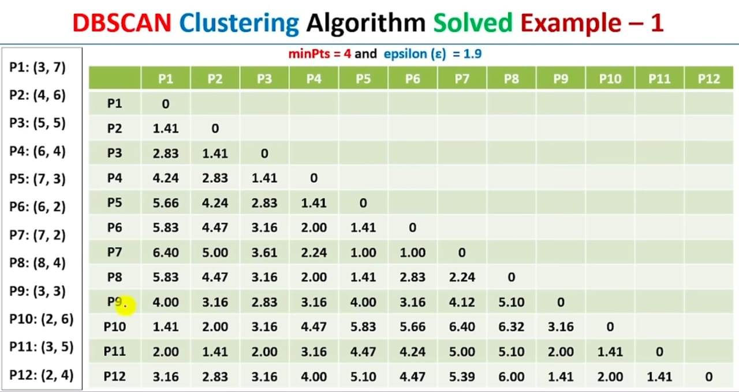

Slide 26
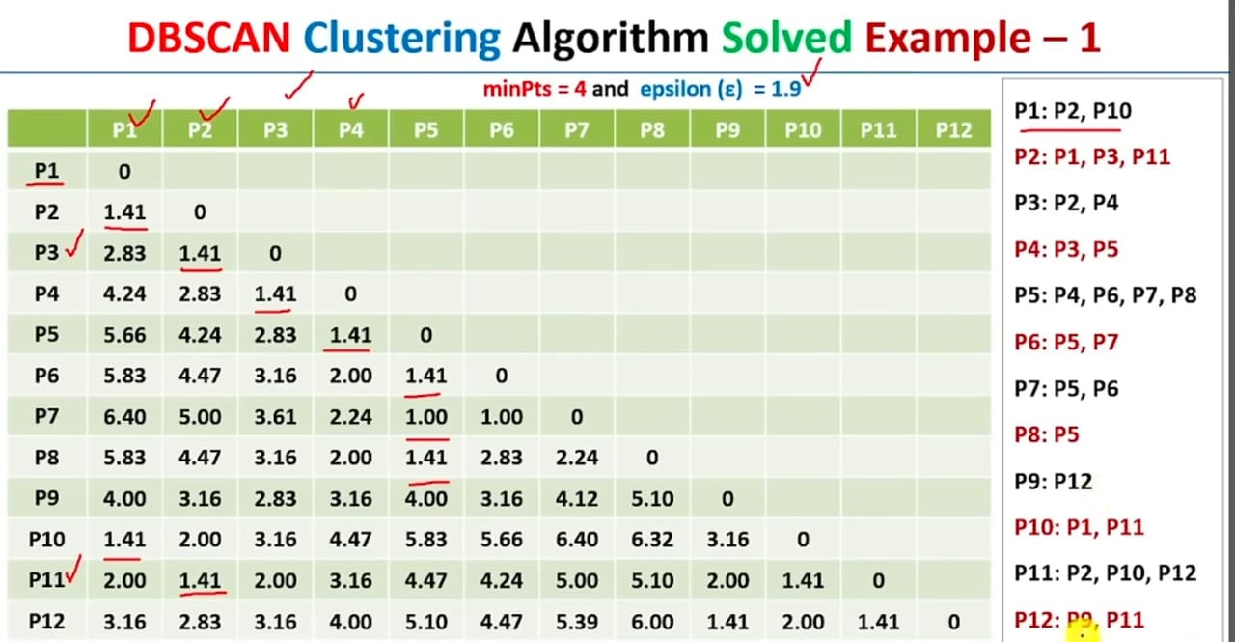

Slide 27
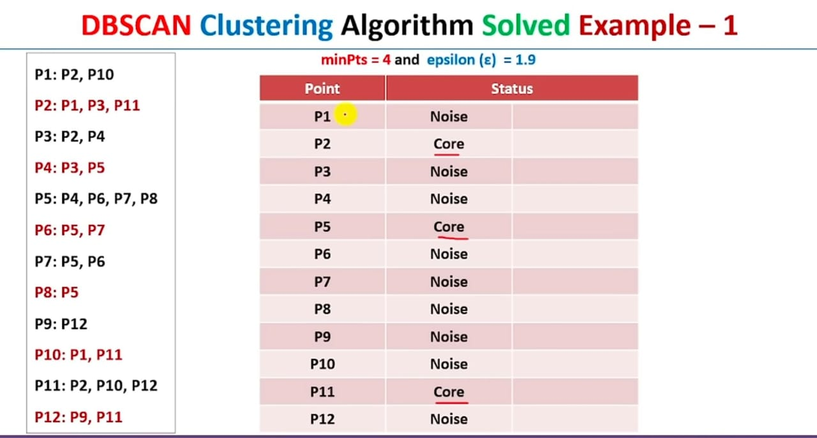

Slide 28
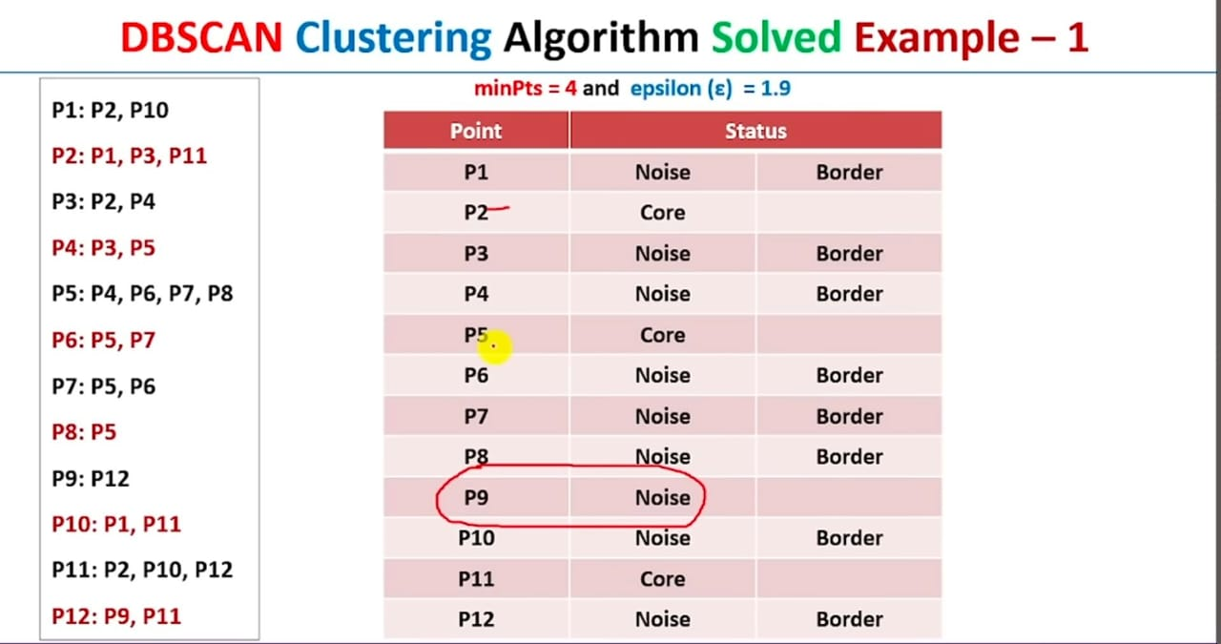
Noise
P9 is an outlier

Slide 29
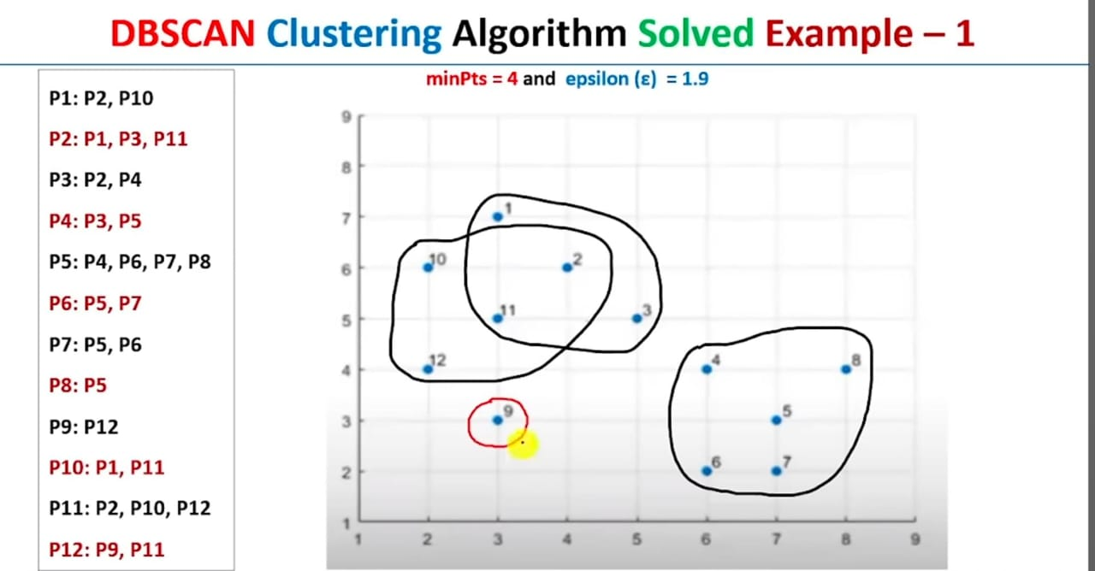

Slide 30
Other Density-based Clustering algorithms
1. HDBSCAN (Hierarchical DBSCAN)
Extends DBSCAN by:
Building a hierarchical tree of clusters over varying density thresholds.
Selecting clusters that are most stable over ε values.
Advantages:
Works well with varying densities.
No need to choose ε manually.
Produces hierarchical structure and cluster stability scores.
Limitations:
Slightly more complex.
Computationally heavier than DBSCAN.

Slide 31
2. OPTICS (Ordering Points To Identify the Clustering Structure)
Like DBSCAN, but instead of fixed ε, it creates an ordering of points that captures cluster structure at multiple density levels.
Each point has a reachability distance.
Clusters can be extracted from the reachability plot.
Advantages:
Handles varying density clusters better than DBSCAN.
Provides multi-scale clustering without picking a single ε.
Limitations:
Slightly more complex interpretation (reachability plot).
Slower on large datasets.

Slide 32
3. DENCLUE (DENsity-based CLUstEring)
Models data density using influence functions (e.g., Gaussian kernel).
Clusters correspond to density attractors (local maxima in the density function).
Advantages:
Mathematically elegant (continuous density model).
Can find arbitrary-shaped clusters.
Efficient for large datasets.
Limitations:
Requires kernel bandwidth parameter tuning.
Sensitive to parameter settings.

